Slide 1

Basic course7-Car Run
Yahboom
Yahboom OMIBOX Tutorial

Slide 2
1
2
3
4
5
Learning
goals
Search for
blocks
Combine
blocks
Experimental
phenomena
Preparation
程序编程
Tencent
Yahboom OMIBOX Tutorial

Slide 3
1
Preparation-1
1. The position of the motor in the robot car
2. Learn how to control motion state of robot car by graphically programming
Yahboom OMIBOX Tutorial

Slide 4
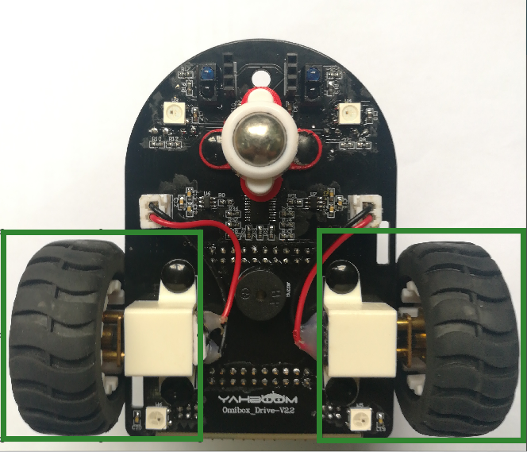
1
Preparation-2
As shown in the figure above, we circled the red wire frame with the motor and wheel, and we can use it by programming.
Yahboom OMIBOX Tutorial

Slide 5
2
Learning goals
In this lesson, we will learn the use of Robot sport building blocks to control the motion state of the robot car by programming.
Yahboom OMIBOX Tutorial

Slide 6
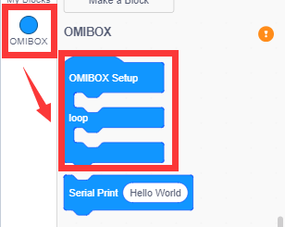
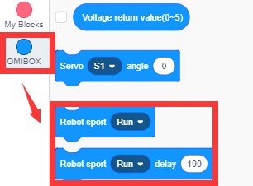
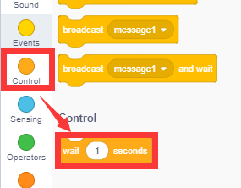
3
Search for blocks
The following is the location of the building blocks required for this programming.
Yahboom OMIBOX Tutorial

Slide 7
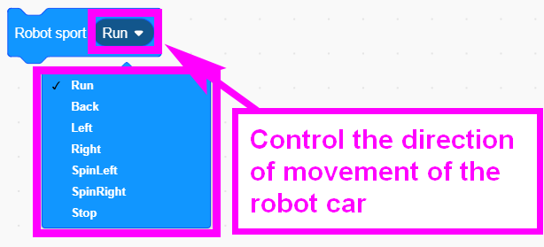
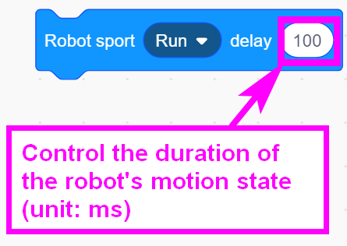
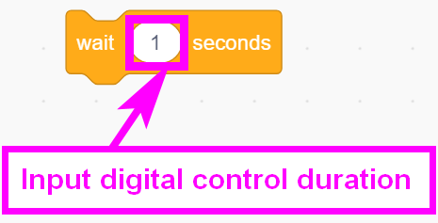
3
Search for blocks
Yahboom OMIBOX Tutorial

Slide 8
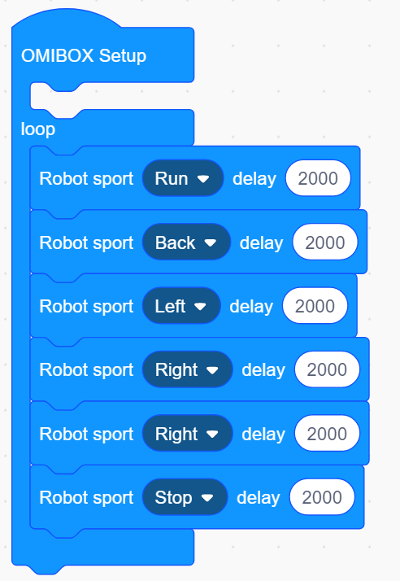
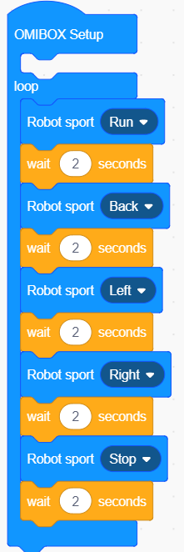
4
Combine blocks
The summary program is shown below:
Method1：
Method2：
Yahboom OMIBOX Tutorial

Slide 9
5
Experimental phenomena
After the program is uploaded, open the power of the car. The car will advance 2 seconds, back 2 seconds, turn left 2 seconds,turn right 2 seconds, stop 2 seconds, and continue to cycle.
!!!Note: The speed of robot car is set at the bottom of the building block is the maximum value of 255, because the center of gravity of the car is at the rear, so the car may lean backwards when moving forward.
This is normal, we only need to adjust the speed of the car.
The way to adjust the speed, we will talk about the next lesson.
Yahboom OMIBOX Tutorial

Slide 10
Inspire Creativity Embrace Innovation
Thank you!!!
Yahboom

